Slide 1


Introducing AP® Computer Science Principles
Creative Thinkers Wanted
Notes:
[Replace Image]

Slide 2
Myth vs. Reality
MYTH: Computer Science is all about word processing, sending email, and using the Internet.
REALITY: While computer science makes those things possible, it’s less about using specific applications than using the computer to address problems through new applications.
MYTH: Computer science consists of sitting in front of a computer by yourself, coding for hours on end.
REALITY: Computer science is creative and collaborative! Computers are elaborate tools for solving real-world problems, and teamwork is essential to developing those solutions.
MYTH: When I think of computer science, the only career that comes to mind is programming.
REALITY: Studying computer science can lead to hundred of career paths, including 3-D animation, engineering, entertainment, app development, medicine, visual design, robotics, political analysis and much, much more.

Slide 3
Myth vs. Reality
MYTH: Computer science is only for boys.
REALITY: Computer science is for everyone. Boy or girl, if you are creative, like to work in a team, and are interested in how technology can solve problems, computer science is for you.
MYTH: I’m not good at math, so I won’t be good at computer science.
REALITY: Like all sciences, computer science does involve math, but not everything is 1s and 0s. Language skills and critical thinking are just as, if not more, important for success.

Slide 4
What do celebrities and peers say about computer science?
<Note: Present one or more videos from code.org – students celebrating the empowerment of coding.>
Computer Science Matters – Starring Bill Gates, Mark Zuckerberg, Makinde Adeagbo, Karlie Kloss, Kevin Systrom, Paola Meija Minaya, Drew Houston, and President Barack Obama
Karlie Kloss: Coding is a superpower
NBA start Chris Bosh on Computer Science

Slide 5
What is AP® Computer Science Principles (AP CSP)?
Did you know that of the more than 9 million STEM jobs available in the next decade, half will require computing experience?
AP CSP, launching in fall 2016, prepares you by:
Introducing you to the essential ideas of computer science.
Challenging you to explore how computing and technology impact the world around you.
Providing a foundation of knowledge that can be applied across disciplines, no matter what your major or career focus- from STEM fields to music and the arts. Chances are, no matter what field you’re interested in, computers play a role.

Slide 6
What makes AP® CSP special?
Creatively address world issues and concerns
Use the same processes and tools as artists, musicians, engineers, computer scientists and others to bring ideas to life
Conceptualize and build digital projects, such as videos or mobile apps, that have practical, real-world use
Learn how to identify threats to cybersecurity and ways to use the internet to address such concerns
“AP Computer Science Principles opened my mind to just about everything. I learned that computer science and programming is not just for some people — it’s for anybody.” — Mikiyah Smith, Sophomore

Slide 7
What do my peers say about AP CSP?
<Note: Present one or more videos from The College Board YouTube Channel at www.youtube.com/advancedplacement featuring students and teachers talking about the value of AP® CSP.>
Introducing AP Computer Science Principles
Explore AP CSP: Hamed expresses himself through code
Explore AP CSP: Kaila reveals self-created travel app
Explore AP CSP: Lily introduces ABC’s app for kids

Slide 8
What do my peers say about AP CSP?
Students who took AP CSP in pilot schools say the course
Gives the autonomy to pursue their passion
Prepares for many different jobs in the future
Gives freedom to select computing innovations they want to investigate
Allows students to collaborate with peers to solve problems
Leads to may creative possibilities

Slide 9
How is this course different from AP Computer Science A?
Computer Science A
Computer Science Principles
What it’s about | Programming and problem solving using the Java language | The fundamentals of computing, including problem solving, working with data, understanding the Internet, cybersecurity, and programming
Goal | Developing your skills for future study or a career in computer science or other STEM fields | Broadening participation in computer science and other STEM fields by exposing you to multiple aspects of computing
The exam | One end-of-year exam: multiple choice and free-response | Two projects (one written and one computer-based) during the course One end-of-year exam: multiple-choice

Slide 10
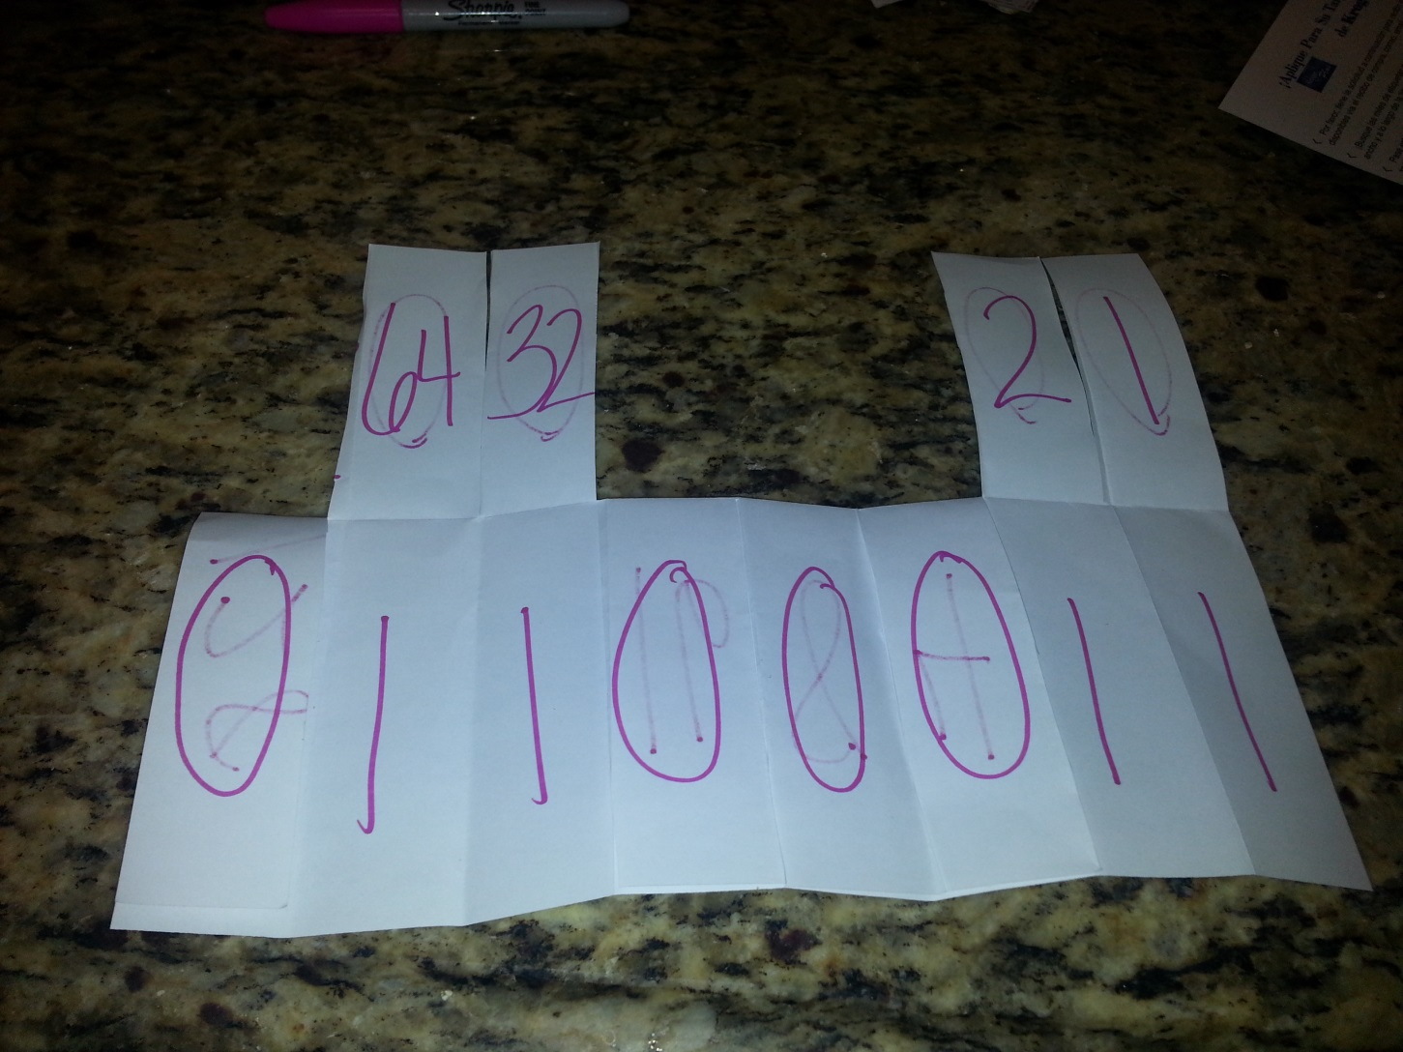
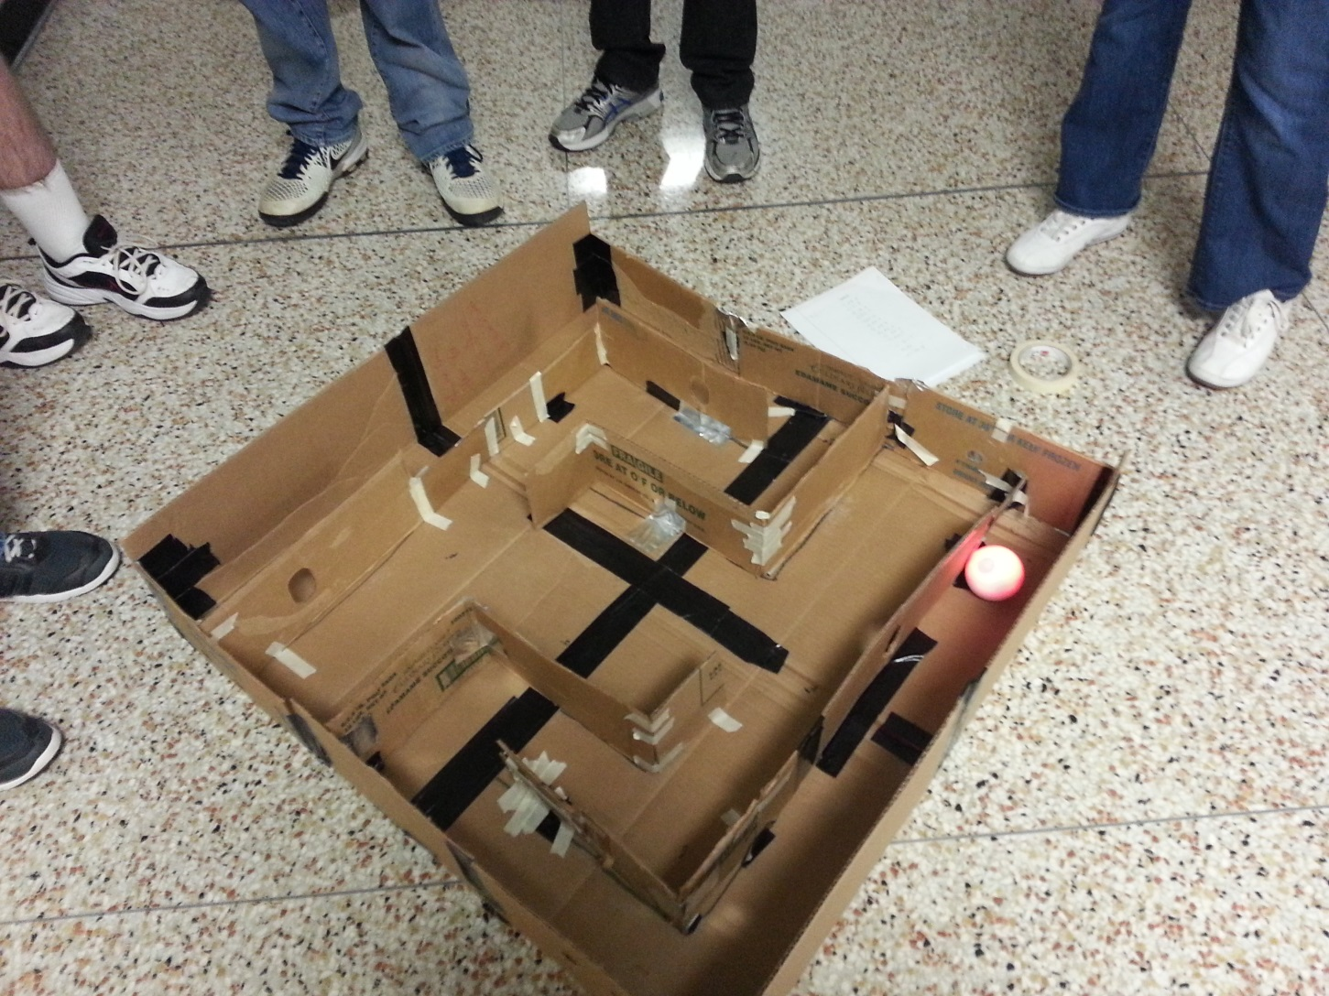
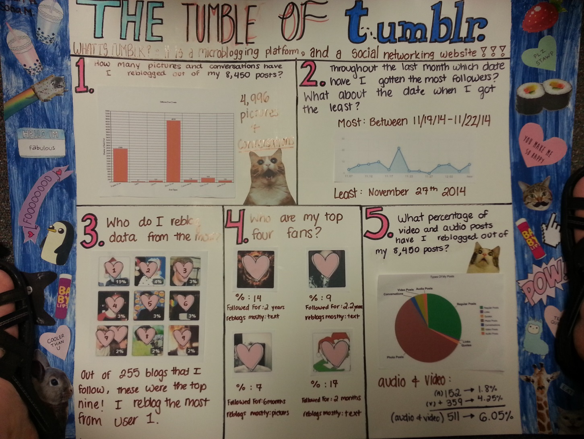
What does the course cover?
Creativity
Create a computational artifact for creative expression.
Abstraction
Explain how binary sequences are used to represent digital data.
Data and Information
Extract information from data to
discover and explain connections,
patterns, or trends.
Notes:
Visit collegeboard.org/CSP Course Details page for more information on what is covered under each big idea.
Big Idea 1: Creativity
Computing is a creative discipline where creation of computational artifacts can take a lot of different forms, like remixing digital music, generating animations, developing websites, and writing programs.
Big Idea 2: Abstraction
In computer science, abstraction is a central problem-solving technique. You will learn how abstraction is a natural part of what they do every day. Some of the areas where abstractions will be taught and applied are in the creation of programs and models and simulations as well as looking at the way in which the computers use abstractions in terms of number systems, like binary, to represent digital data.
Big Idea 3: Data and Information
Data and information facilitate the creation of knowledge. Managing and interpreting an overwhelming amount of raw data is part of the foundation of our information society and technology. In this course you will work with data to discover connections, patterns, or trends.

Slide 11
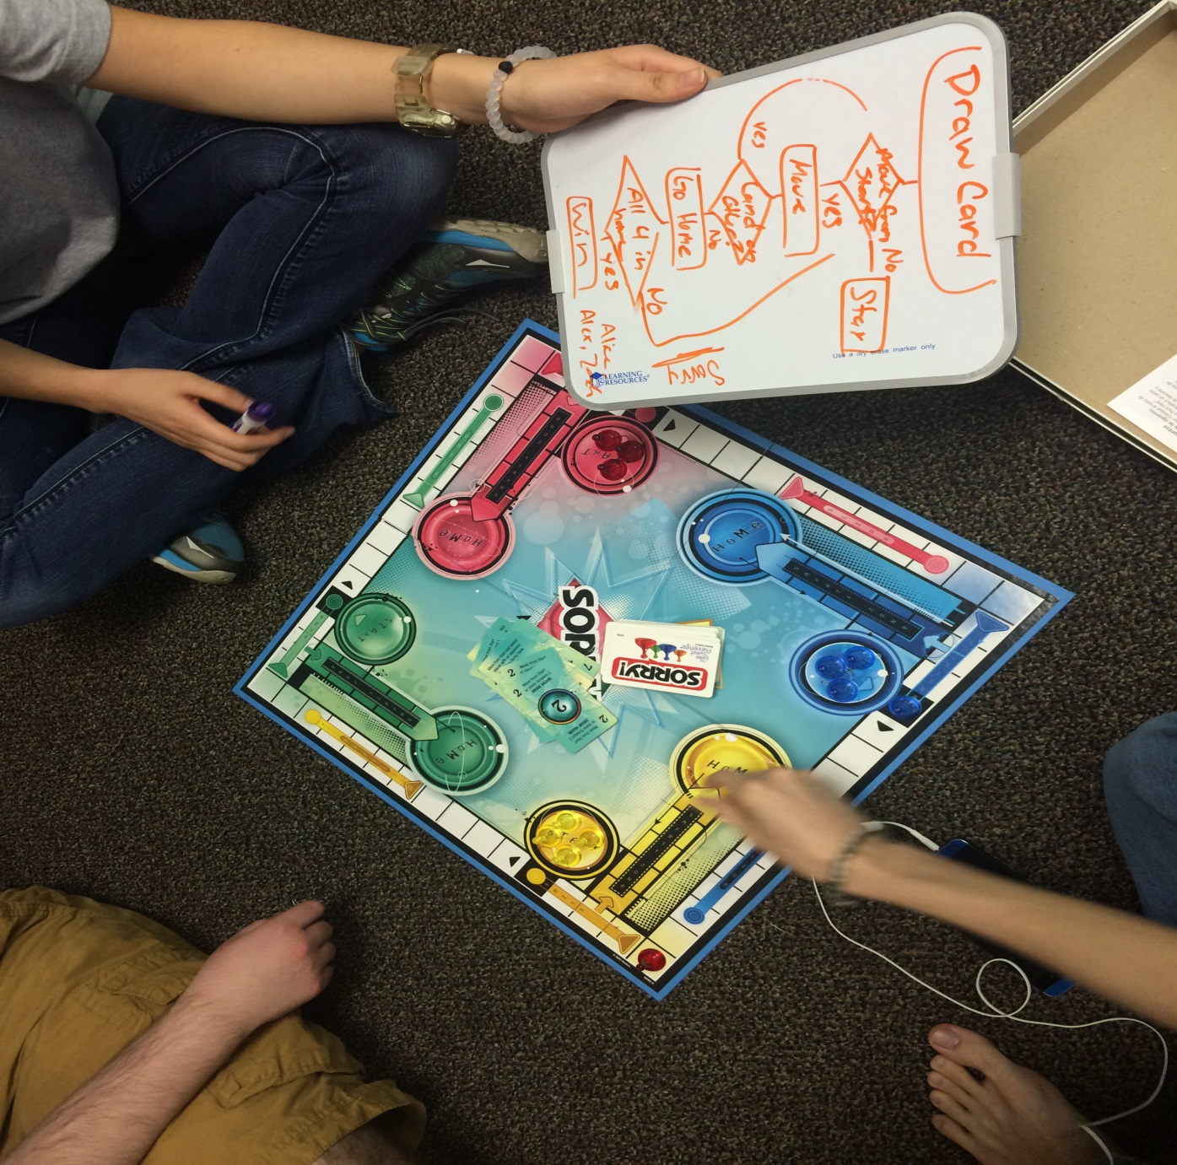
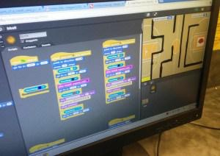
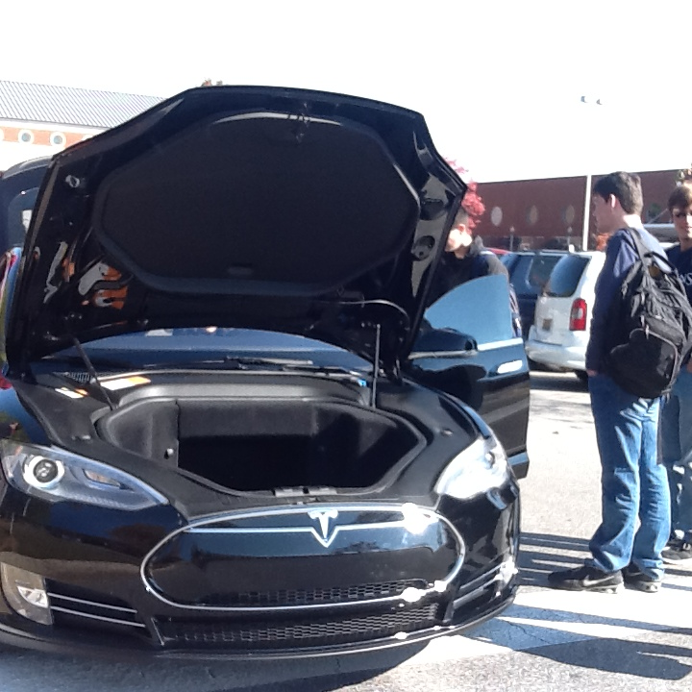
What does the course cover?
Algorithms
Express an algorithm in a language.
Programming
Collaborate to develop a program.
Global Impact
Analyze the beneficial and
harmful effects of computing.
The Internet
Explain characteristics of the Internet
and the systems built on it.
Notes:
Big Idea 4: Algorithms
Algorithms are used to develop and express solutions to computational problems. They are used to describe a process. Think about the rules involved in playing your favorite game and the process or technique you might use to win the game. This process is an algorithm. In this course you will work with algorithms in many ways: You will develop original algorithms, implement algorithms in a programming language, and analyze algorithms.
Big Idea 5: Programming
Programming enables problem solving, human expression, and creation of knowledge. It results in the creation of software, and it facilitates the creation of computational artifacts, including music, images, and visualizations. In this course you will be introduced to the fundamental concepts of programming that can be applied across a variety of projects and languages. You will learn how to work collaboratively to create programs for creative expression or to solve a problem.
Big Idea 6: The Internet
The Internet and systems built on it have a profound impact on society. Many of you are using the Internet to complete homework, conduct research, and to stay connected with your friends. In this course, you will gain insight into how the Internet operates, study characteristics of the Internet and systems built on it, and analyze important concerns such as cybersecurity and how to better keep your information private.
Big Idea 7: Global Impact
Computation has changed the way people think, work, live, and play. In this course, you will become familiar with many ways in which computing enables innovation. Many of you can easily identify the benefits of computing innovations. Your cell phone allow you more freedom because you are able to be reachable by your parents. What you may not have considered are the potential harmful effects of computing. Analyzing both the potential benefits and harmful effects of computing in a number of contexts will help you to weigh these effects when creating your own computing innovations.

Slide 12
What does the AP exam cover?
Part I: Through-Course Assessments
Upload digital artifacts (e.g., a video, spreadsheet, graph, app, electronic slide show) and written responses via a Web-based digital application.
Describe or analyze your work, whether it includes research, the creation of a digital artifact, or the creation of a program.
Part II: End-of-Course AP Exam
Paper and pencil written exam
120 minutes with 74 multiple choice questions
First administration May 2017
Notes:
The AP Computer Science Principles Assessment consists of two parts: a through-course assessment and the end-of-course AP Exam. Both of these parts will measure your achievement of the course learning objectives.
The Through-Course Assessment will allow you to have flexibility and choice in the computational artifacts you will develop. In the Explore Performance task you will investigate a computing innovation that is interesting and meaningful to you. Once you have completed your investigation, you will create a computational artifact using a medium of your choice, such as creating a video, sound, or graphic. When completing the Create Performance Task, you will be allowed to decide what program you will create. The program will either solve a problem or be for your own creative expression. These performance tasks provide you with the opportunity to showcase your interests and what you have learned.

Slide 13


Create The Future
Notes:
[Replace Image]

